Slide 2
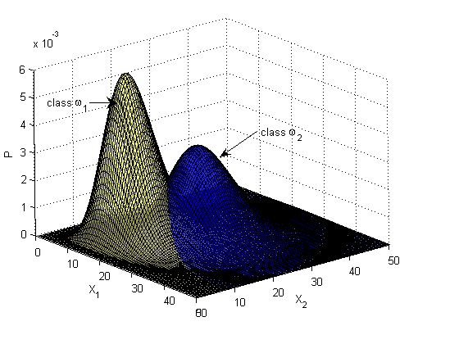
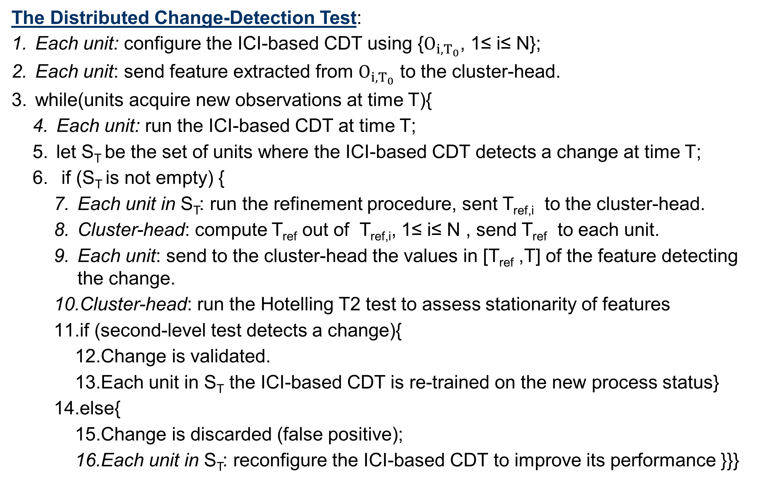
Model ensemble for an effective on-line reconstruction of missing data in sensor networks
Author 1, Author 2, Author 3
Affiliation
k-NN classifiers associate a classification label to an input as the majority of its k nearest training samples
No proper training phase – Reduced computational complexity
Consistency: Bayes errore
Leave-One-Out (LOO)
Fukunaga et Al.
Lack of theoretical results
How to select
k given n?
class
class
point
The proposed algorithm
The Distributed Change-Detection Test:
Each unit: configure the ICI-based CDT using {, 1≤ i≤ N};
Each unit: send feature extracted from to the cluster-head.
while(units acquire new observations at time T){
  Each unit: run the ICI-based CDT at time T;
  let S_{T} be the set of units where the ICI-based CDT detects a change at time T;
  if (S_{T} is not empty) {
    Each unit in S_{T}: run the refinement procedure, sent T_{ref,i} to the cluster-head.
    Cluster-head: compute T_{ref} out of T_{ref,i}, 1≤ i≤ N , send T_{ref} to each unit.
    Each unit: send to the cluster-head the values in [T_{ref} ,T] of the feature detecting the change.
    Cluster-head: run the Hotelling T2 test to assess stationarity of features
    if (second-level test detects a change){
      Change is validated.
      Each unit in S_{T} the ICI-based CDT is re-trained on the new process status}
    else{
      Change is discarded (false positive);
      Each unit in S_{T}: reconfigure the ICI-based CDT to improve its performance }}}
Sensing node 2
Configuration
Sensing node 1
Sensing node 3
Sensing node 5
Cluster
head
Sensing node 4
Execution
Network in stationary conditions .
Sensing node 1
Sensing node 2
Sensing node 3
Sensing node 5
Cluster
head
Sensing node 4
H.T.
Experimental Results
a) a mono-dimensional classification problem with
equi-probable classes ruled by Gaussian distributions (with T=[-4,6]: ,
b) a two-dimensional classification problem
characterized by the two equi-probable classes ruled by chi-square distributions:
The theoretical derivation is experimentally sound
P_{e}(k) w.r.t. k
Number of k within [P_{e}(kº),P_{e}(kº)+δ]
kº w.r.t. n
P_{e}(k) w.r.t. k
Number of k within [P_{e}(kº),P_{e}(kº)+δ]
kº w.r.t. n

